Slide 1

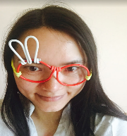


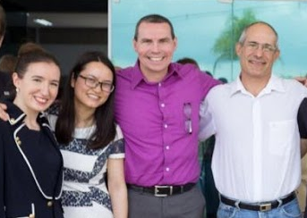
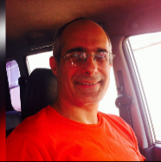

The CSC Robotics Team
Zerrin Citkaya, Turkey
Wan Jiang Liang(Lynn), China
Scott Frei, USA
Prof. Eduardo Simões, Brazil
Team members of this project

Slide 2
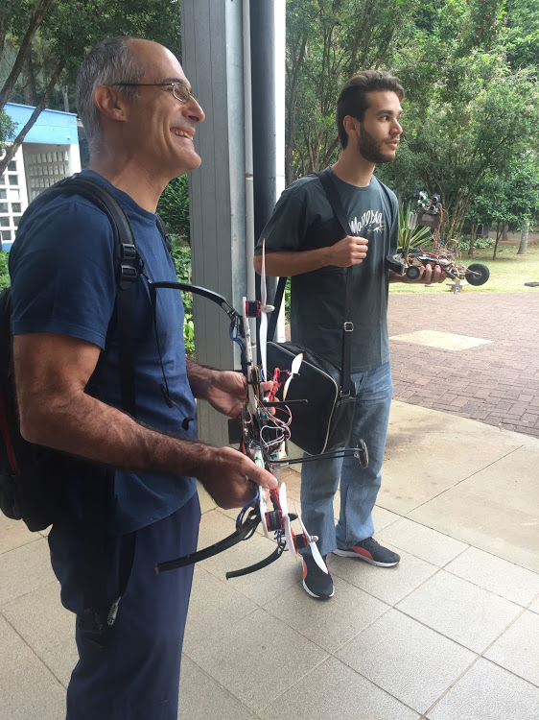
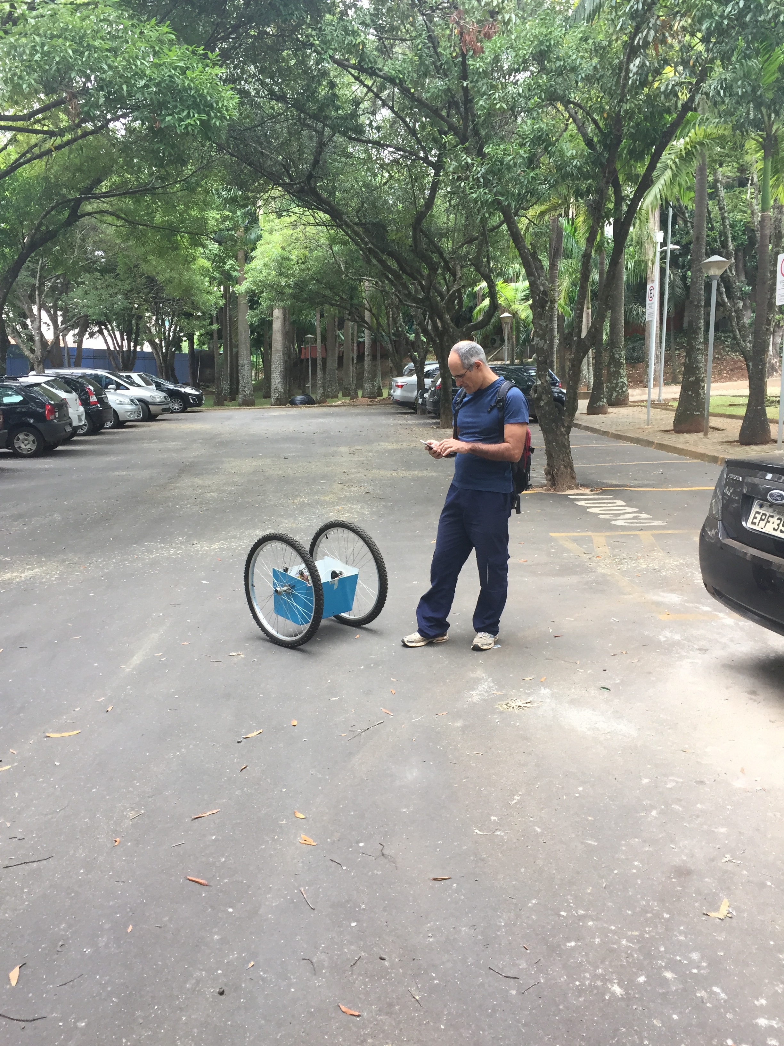
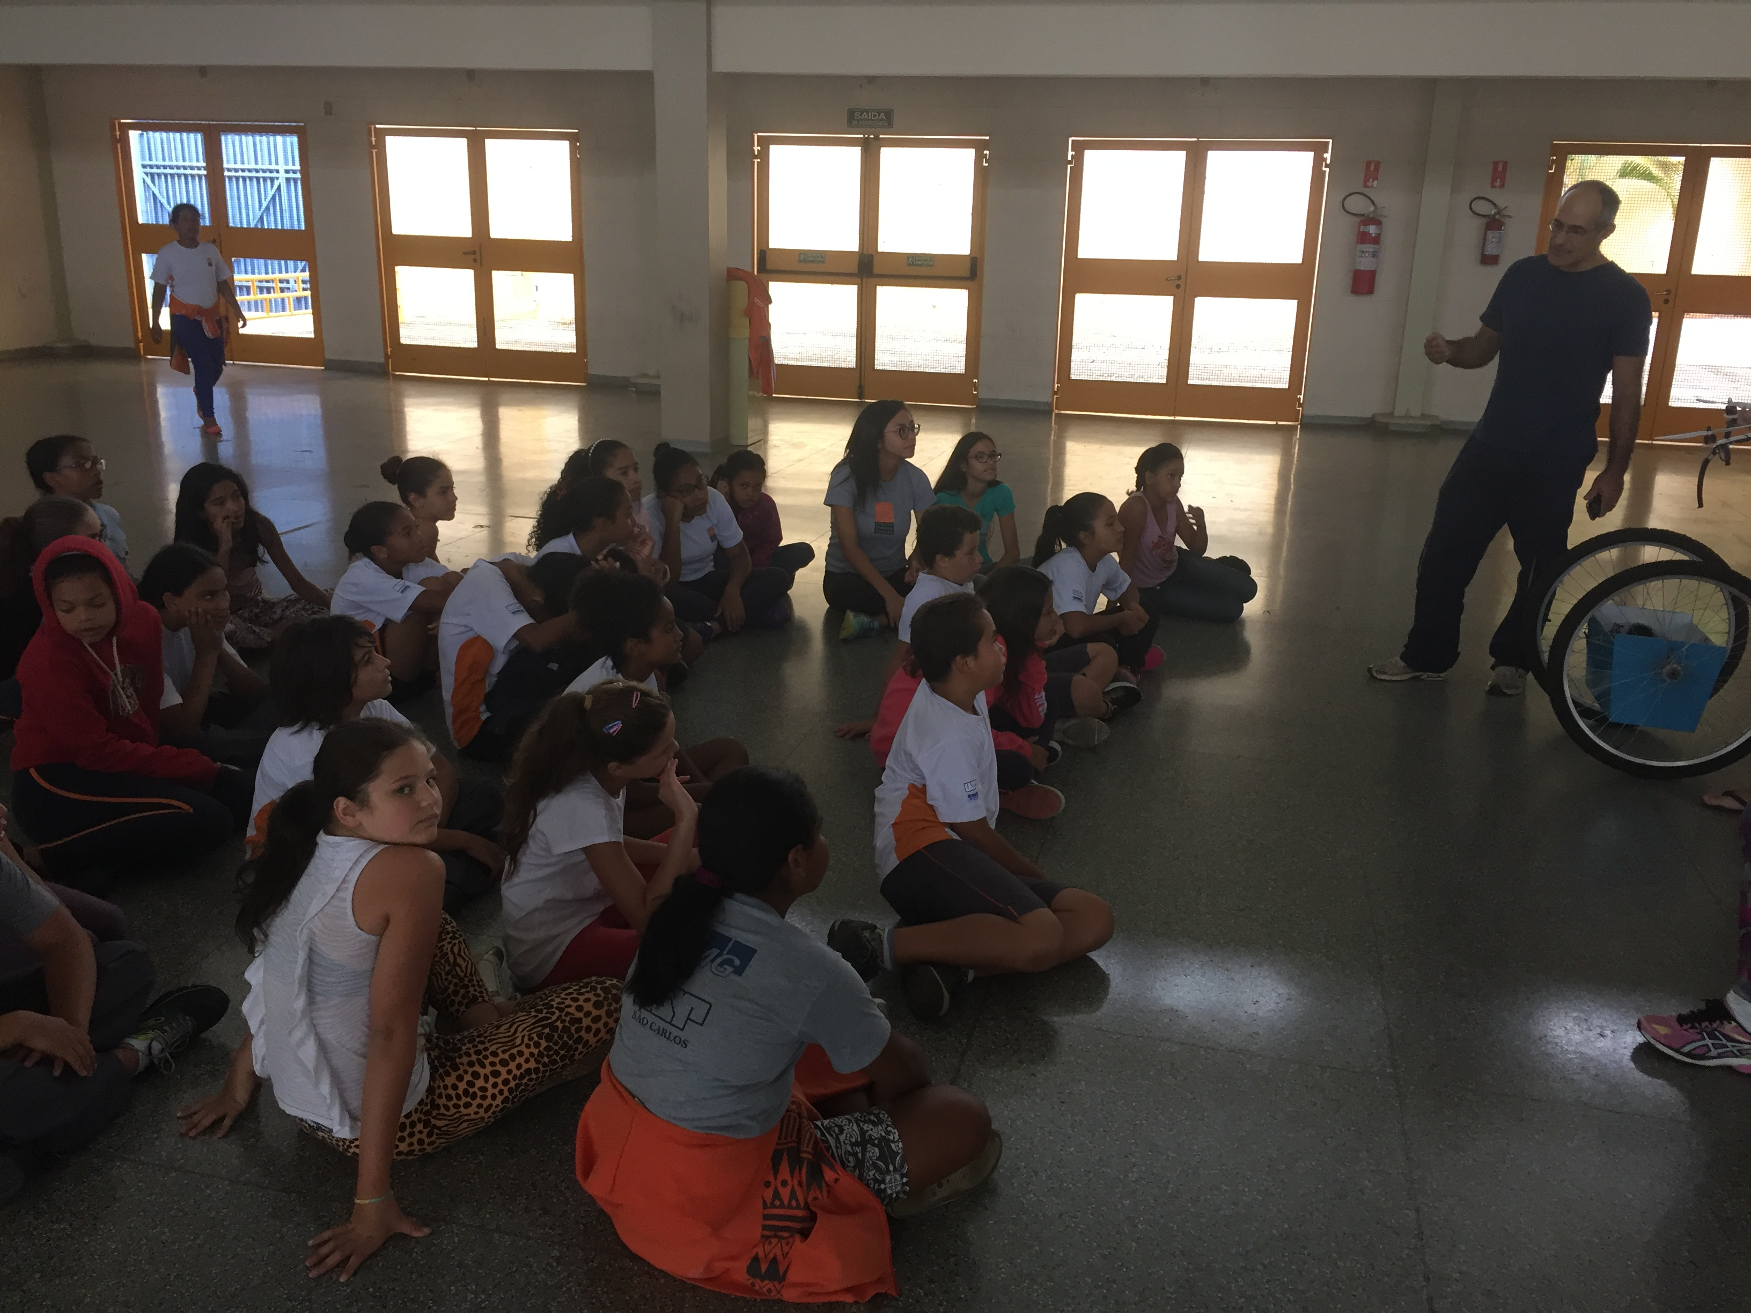
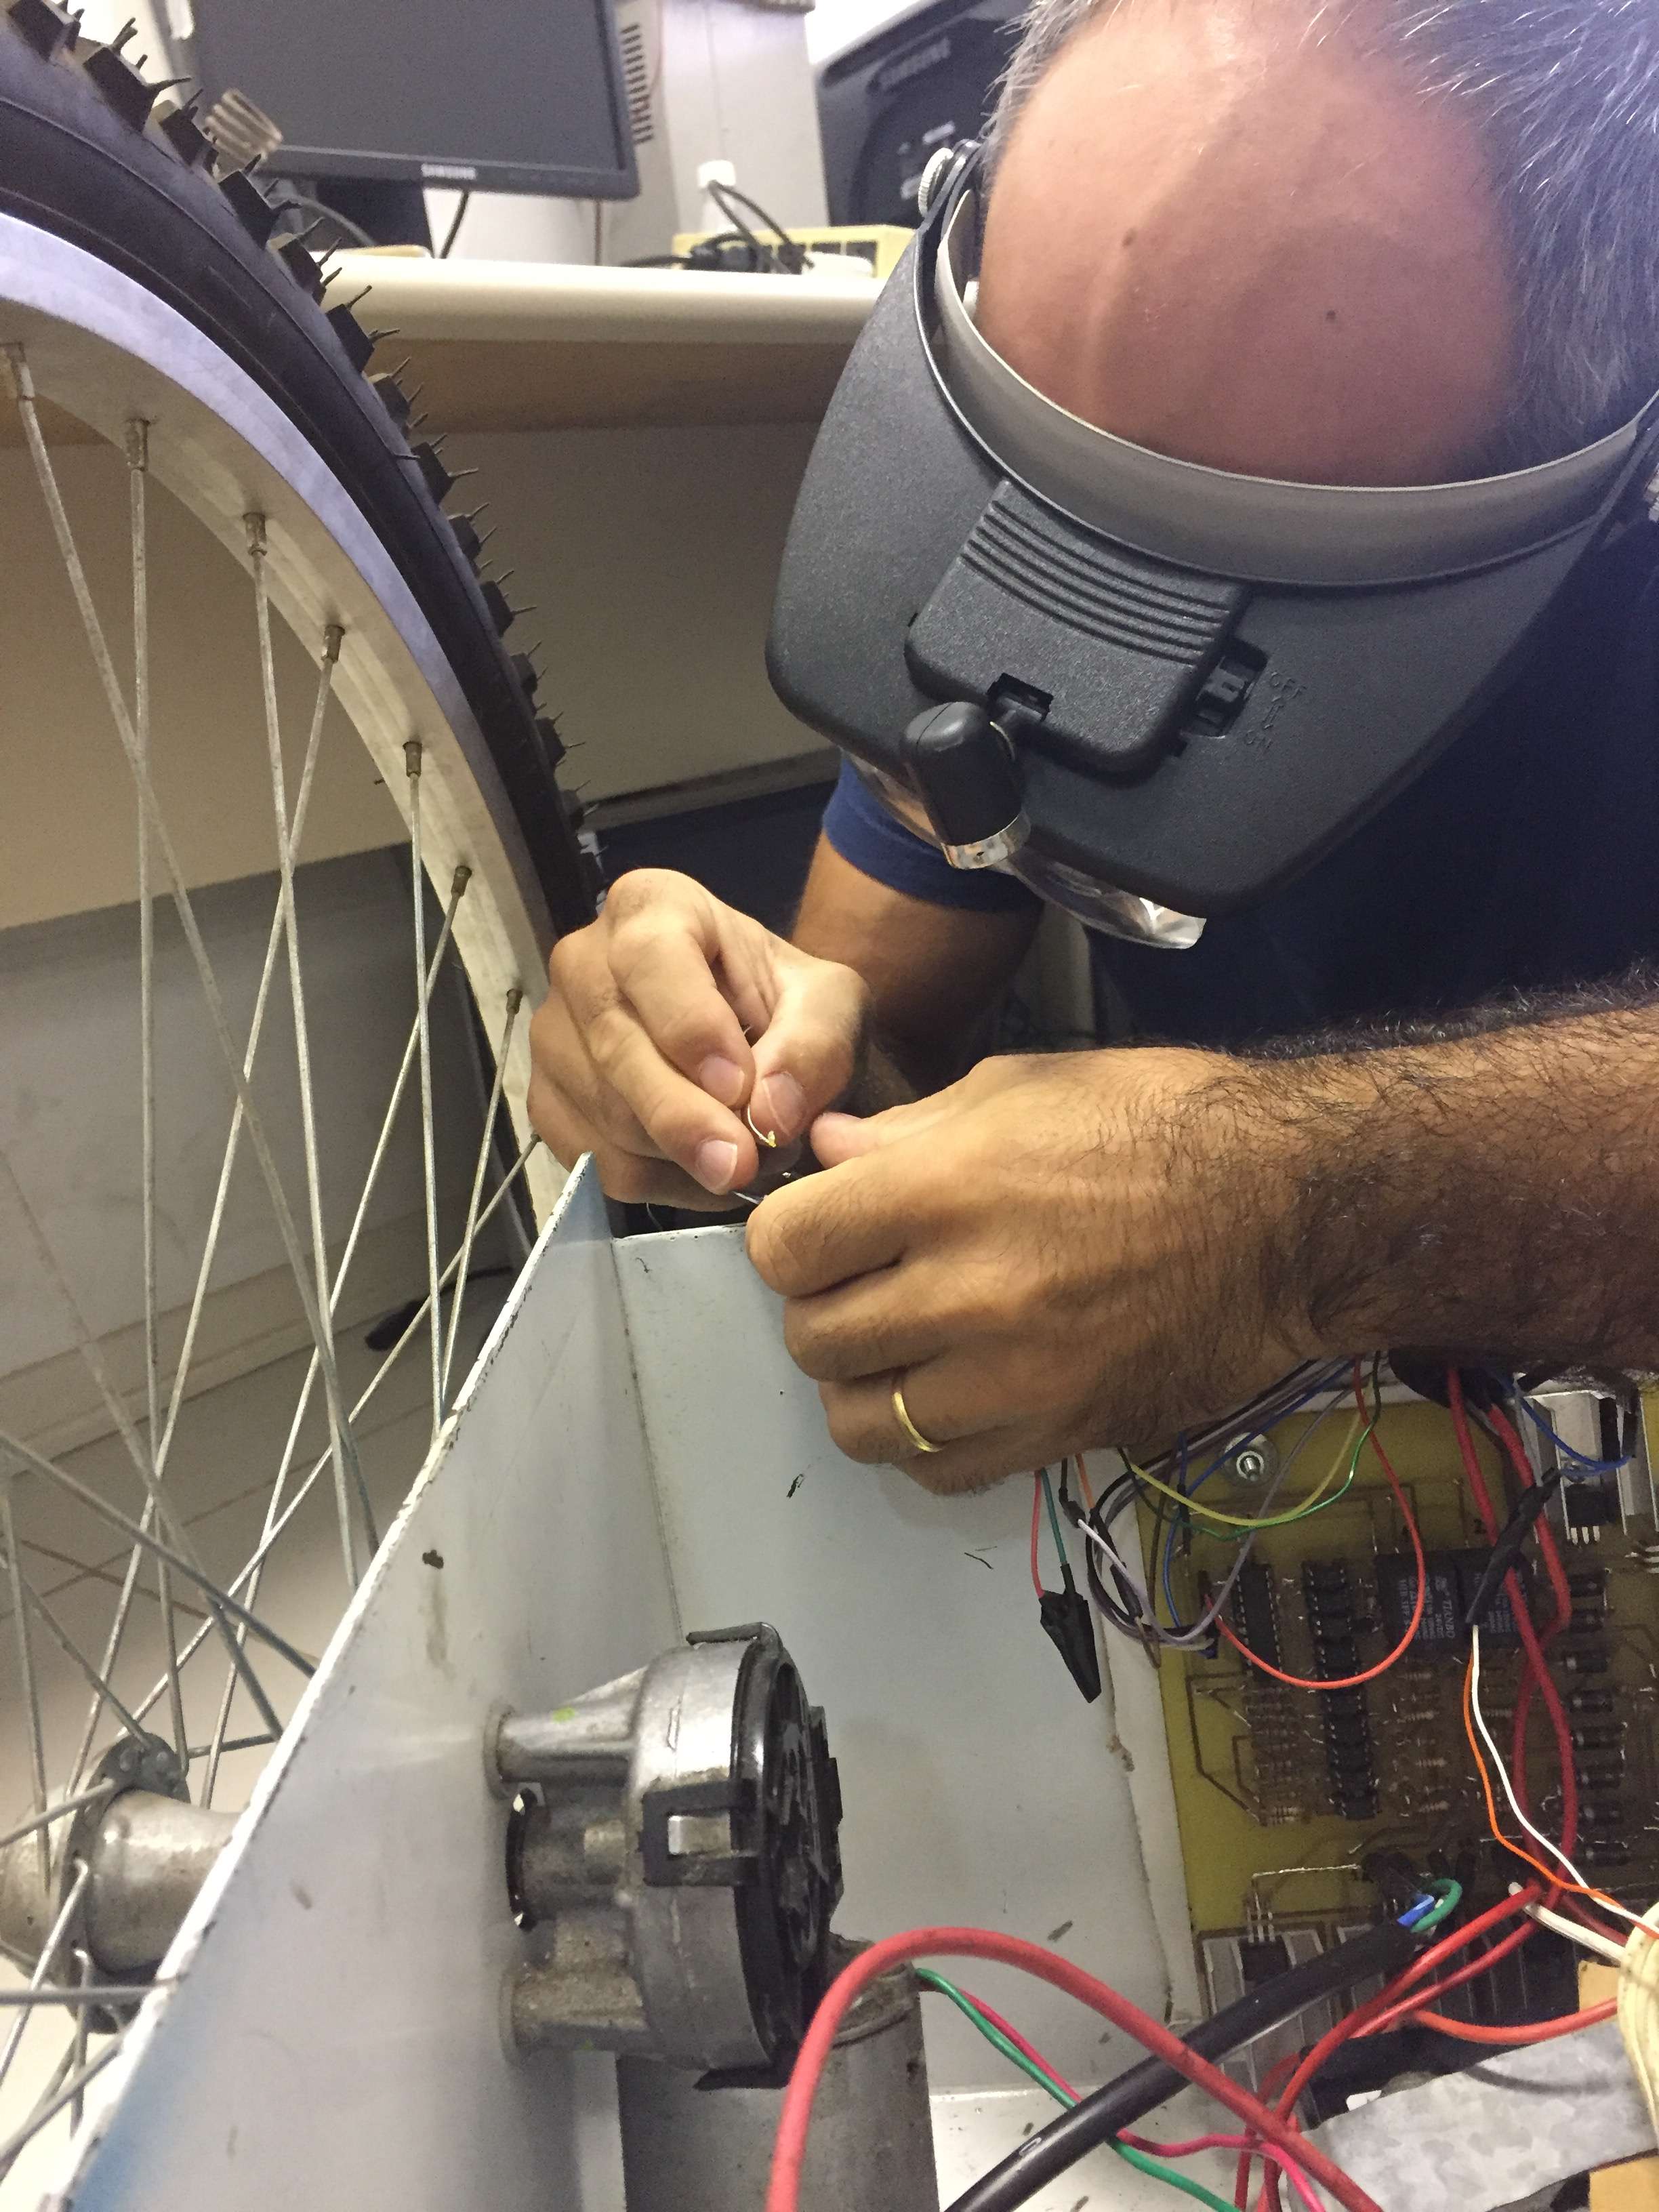
Motivation – Inspire students in poverty to pursue education and careers in STEM by providing an “eye-opening” experience with robotics.
Challenge – Inability to have continuous visits and expansion of program due to time constraints and lack of a supporting structure

Slide 3

Vision – “Every poor child is shown a possible path out of poverty through digital inclusion and education”
Mission – To reach students in poverty and inspire them to attend a public university in Brazil, allowing them to enter a field of technology

Slide 4
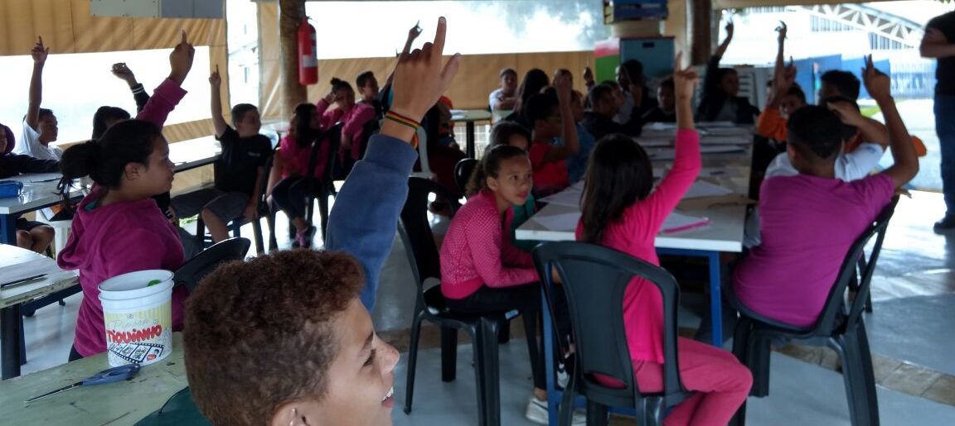
Pilot with Little Citizens

Slide 5
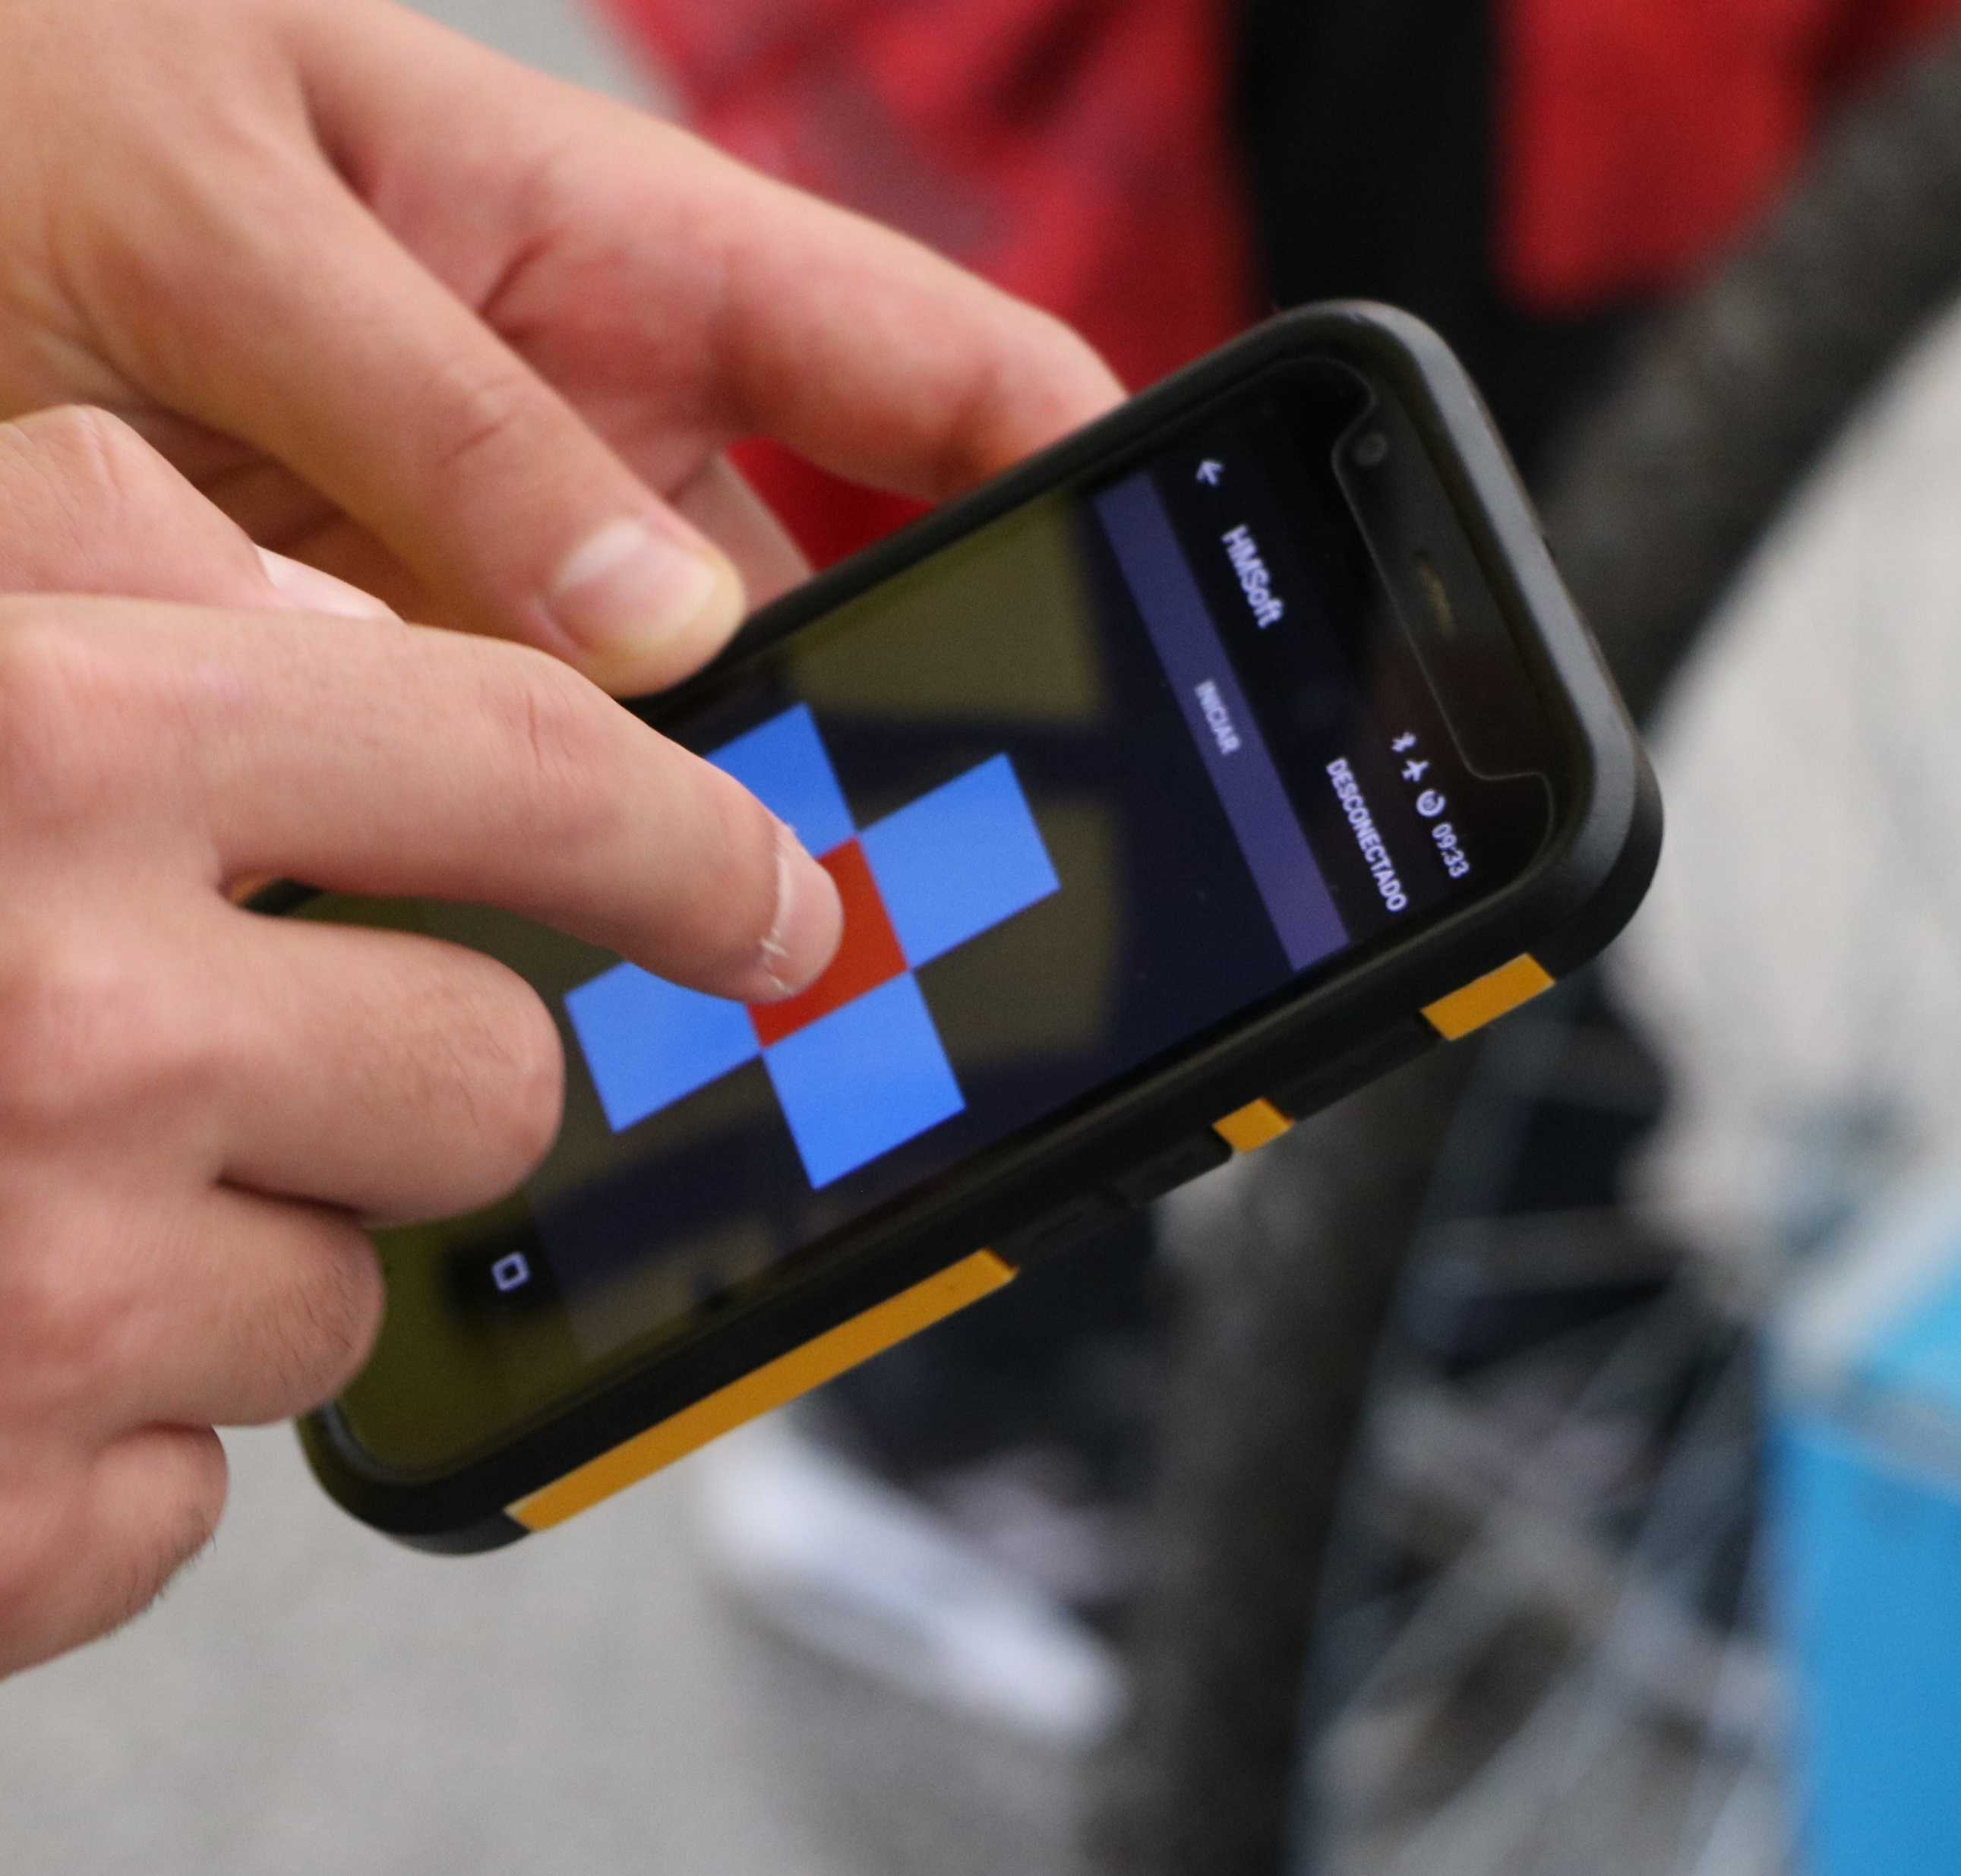
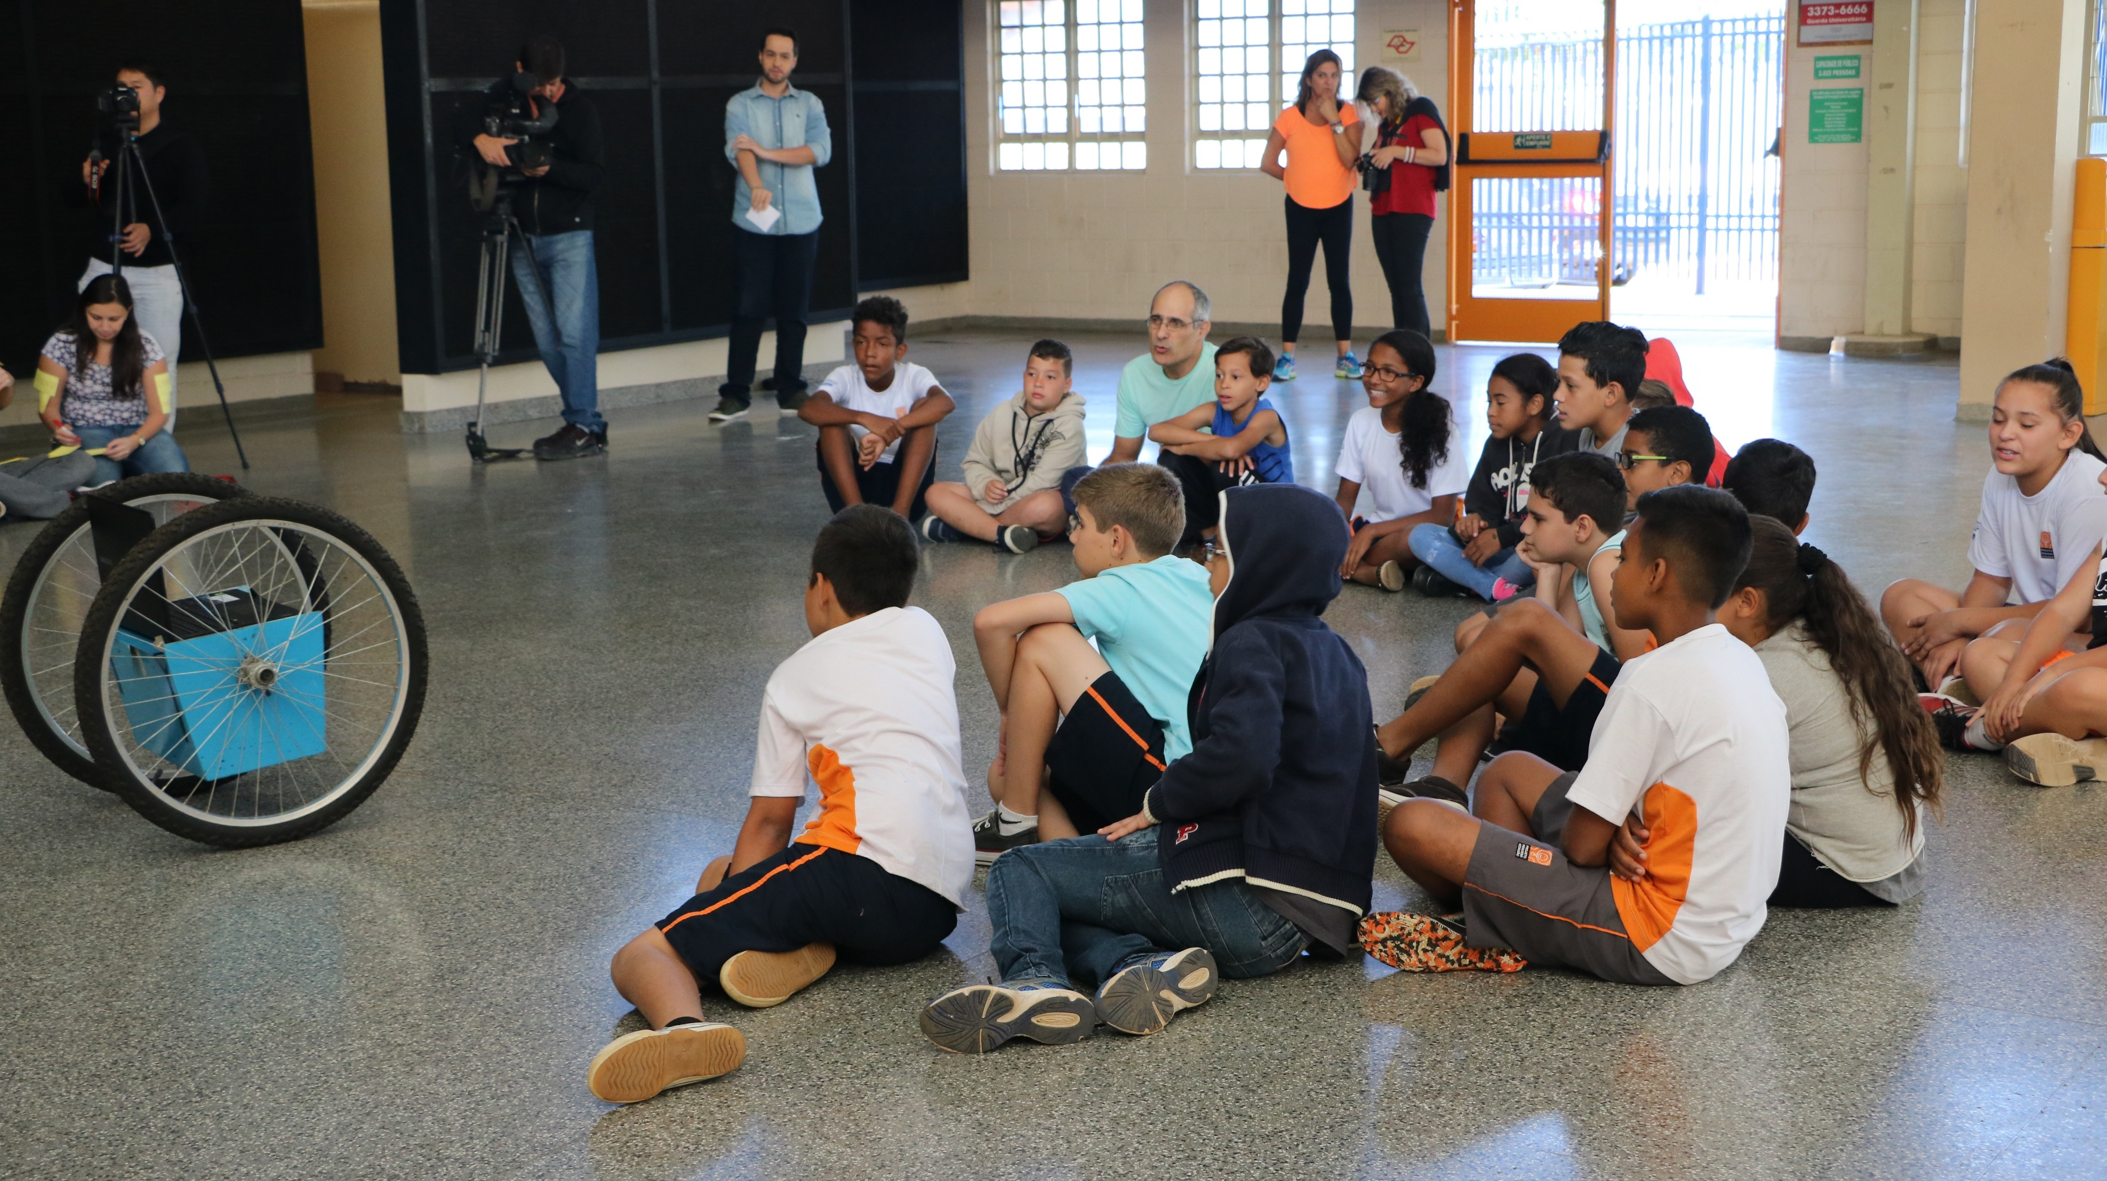
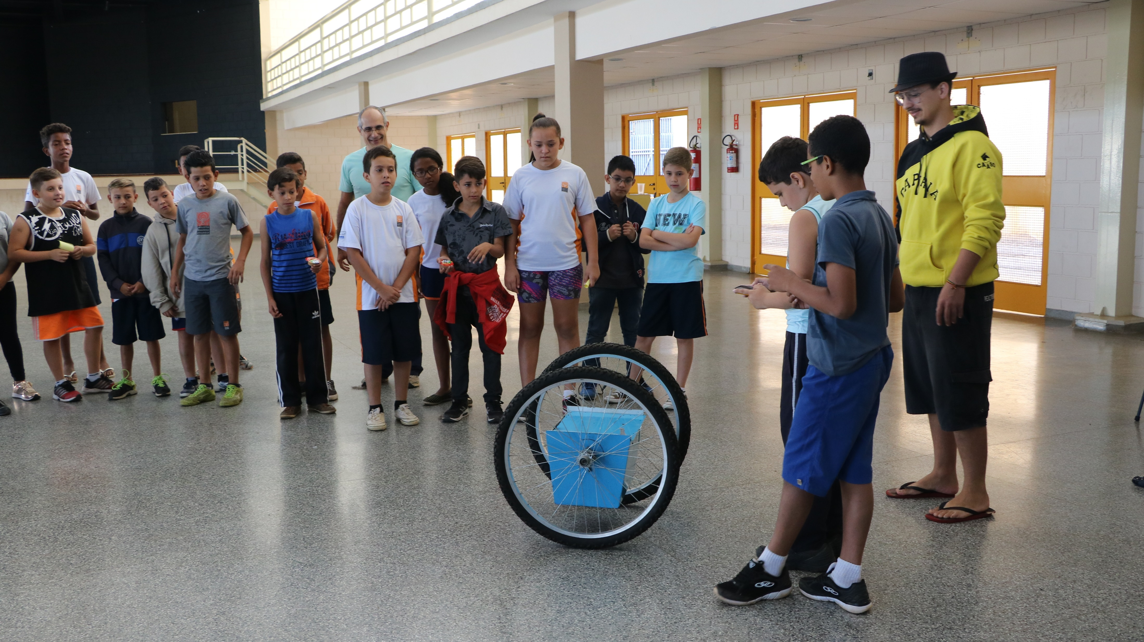
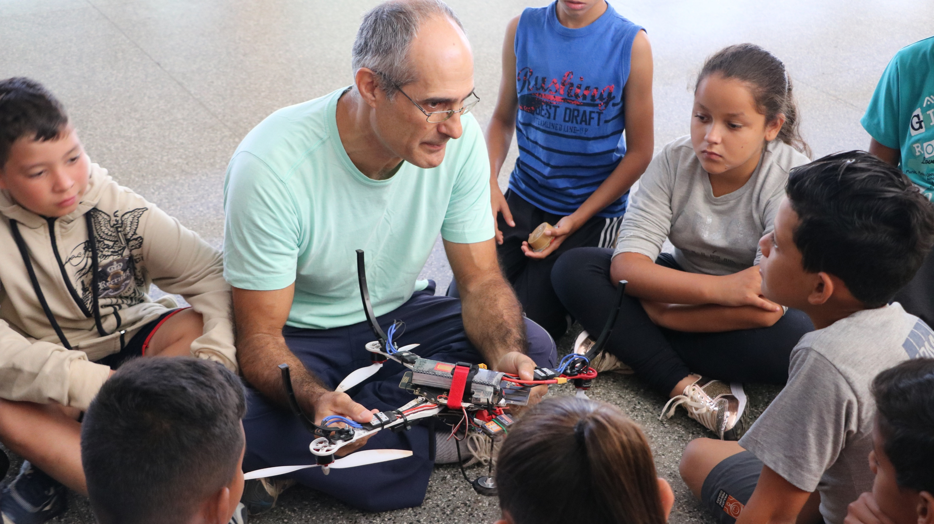
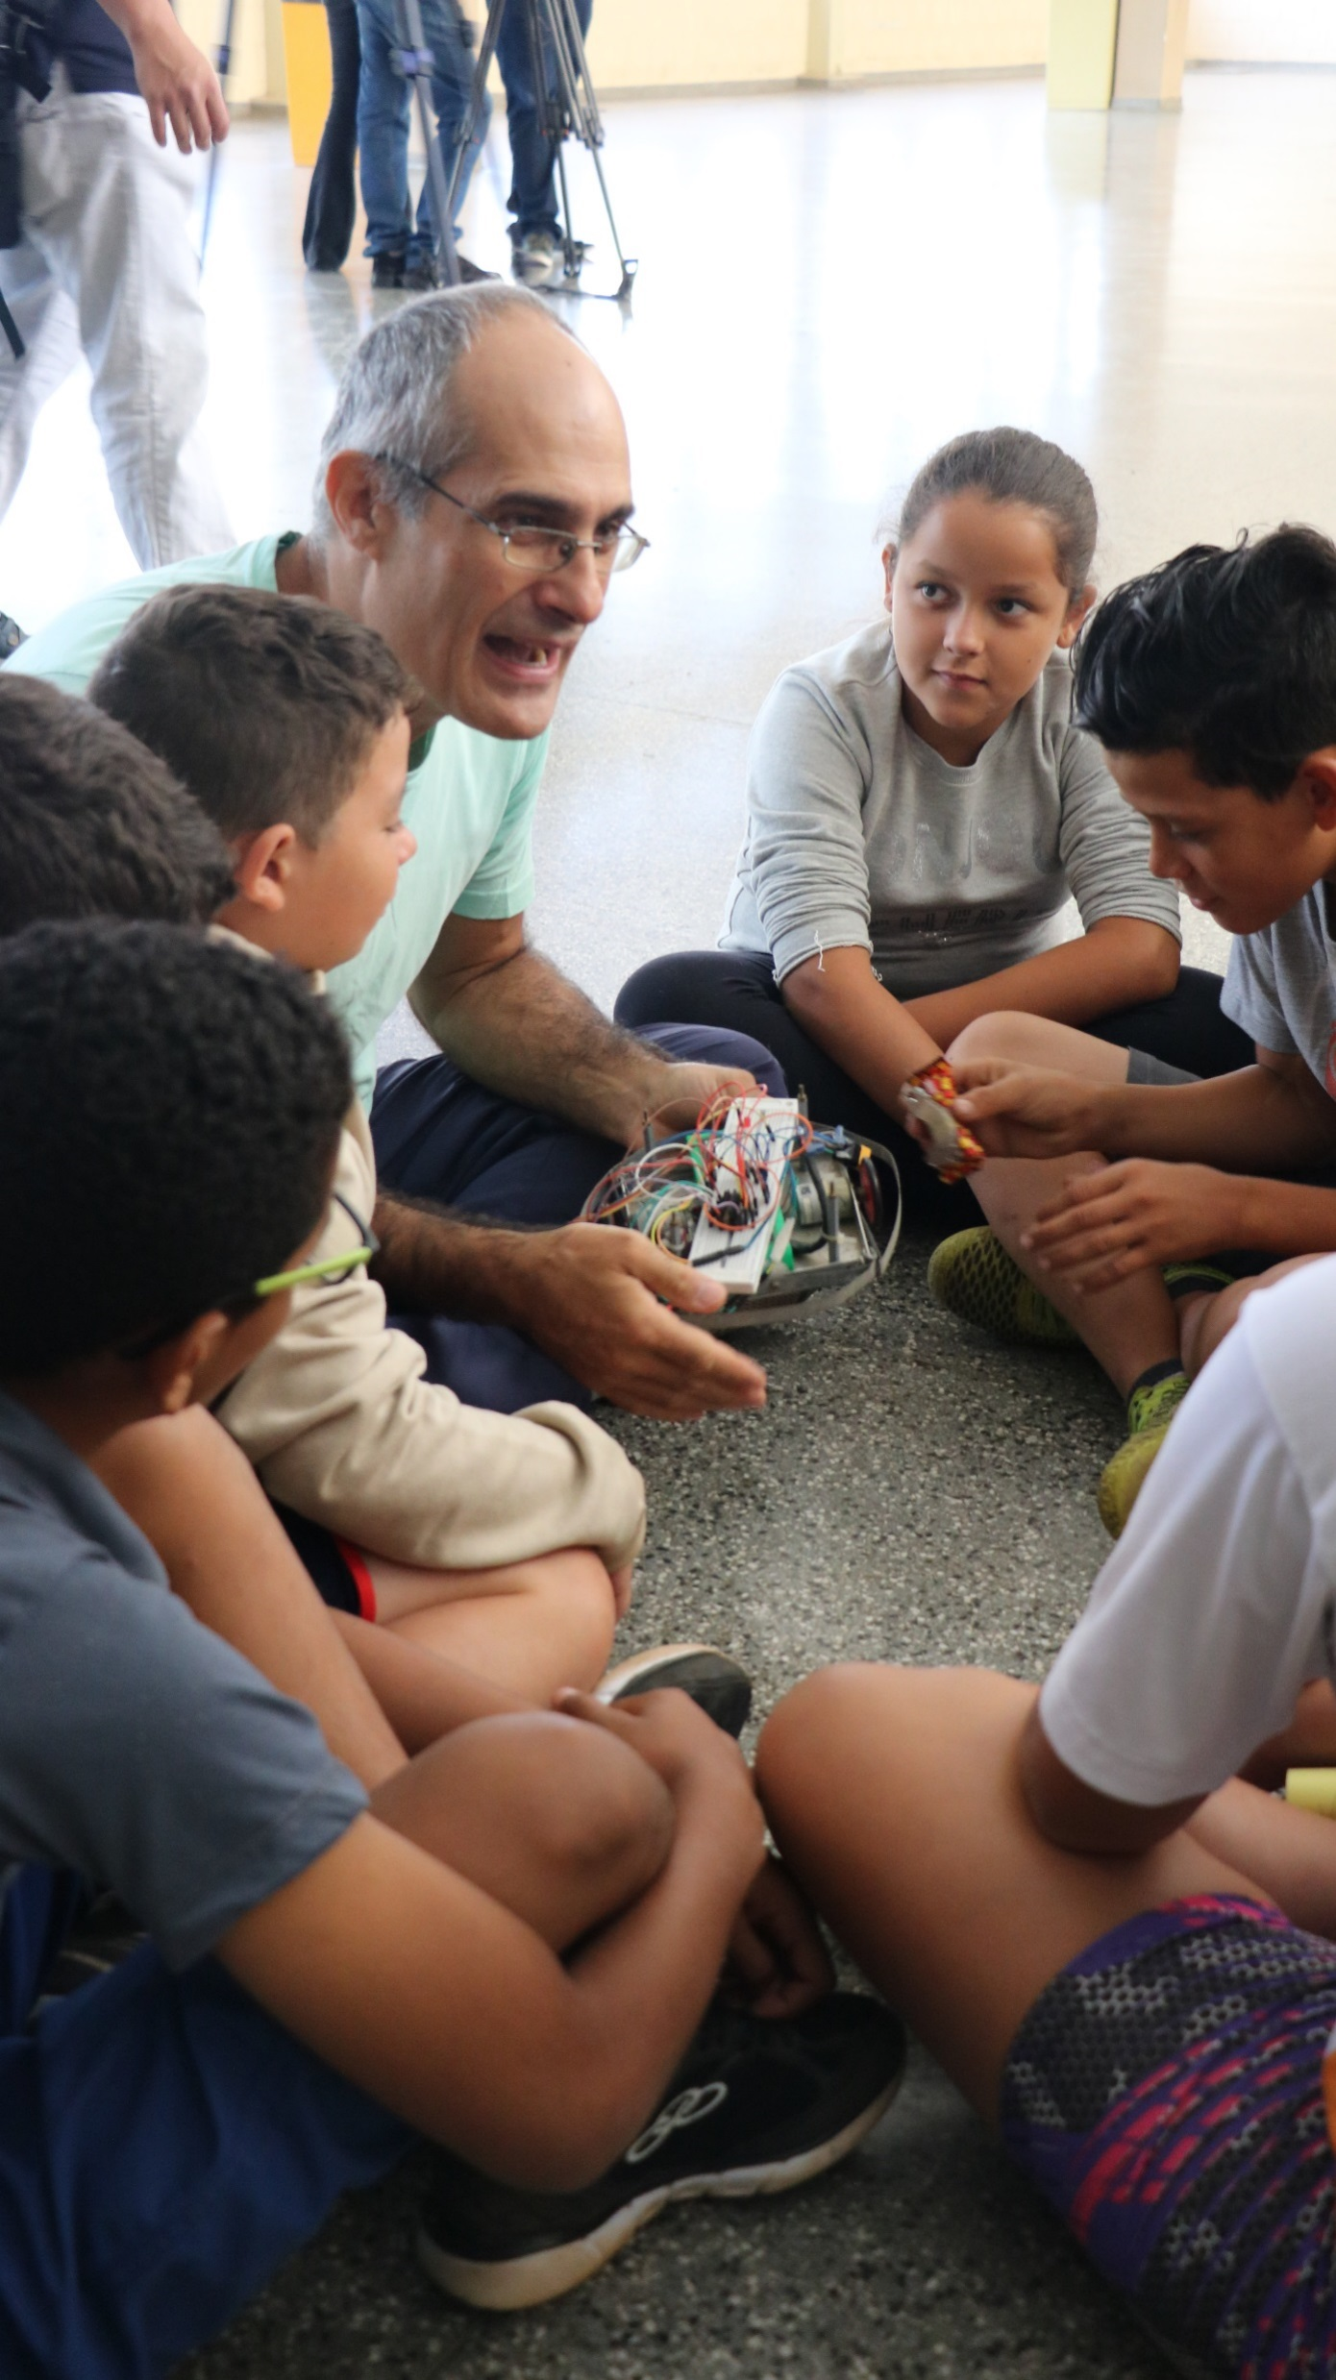
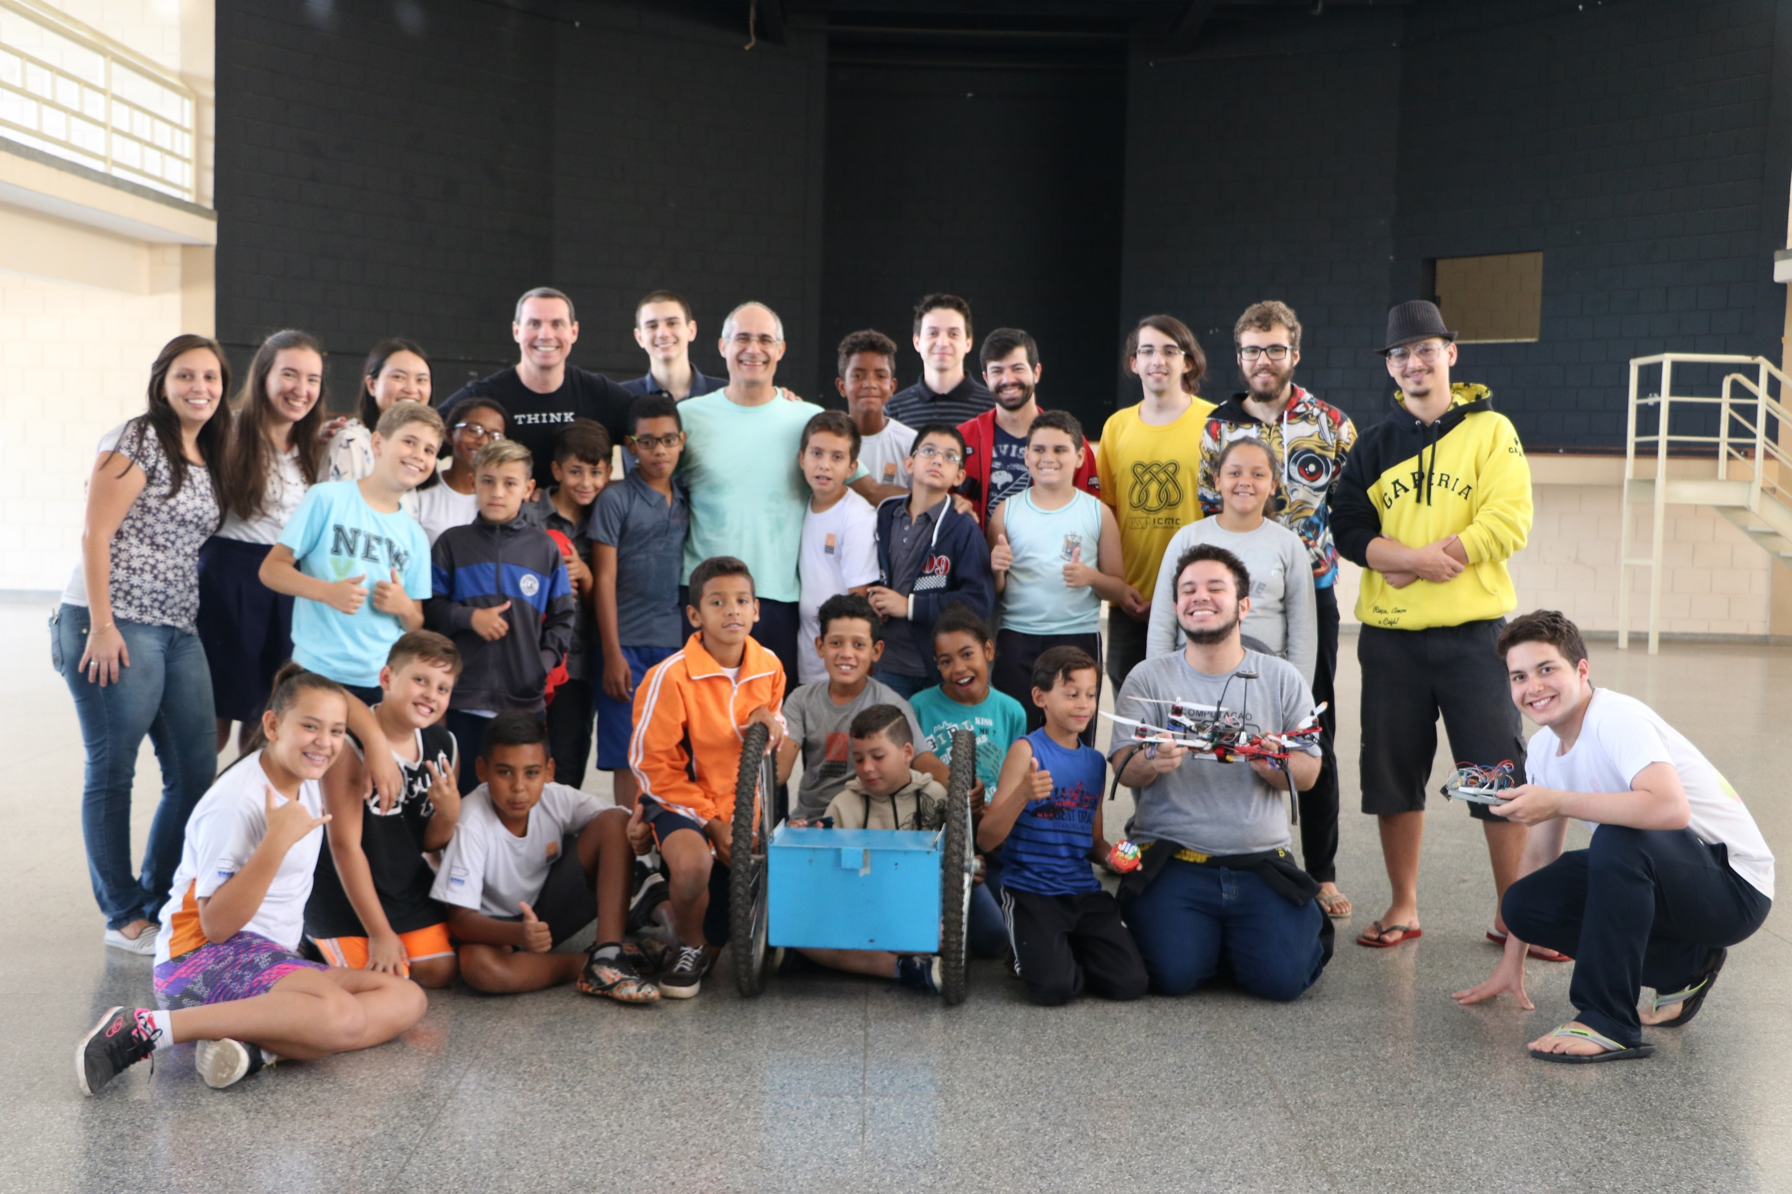

Slide 6
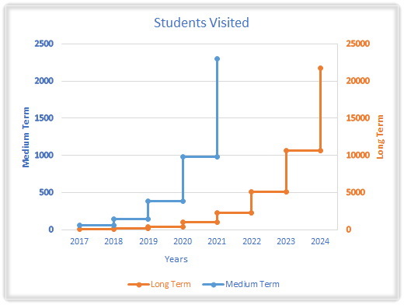
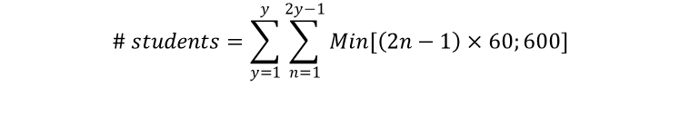
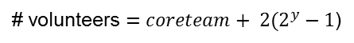
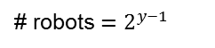
Expansion
Sao Carlos “Primary2” Public
# volunteers $=coreteam+ 2(2^{y}−1$)
# robots $=2^{y−1}$
Ages 10-14
~40 Schools
~10.000 Students
$$\# students=\sum_{y=1}^{y}{\sum_{n=1}^{2y−1}{Min[\left(2n−1\right)×60;600]}}$$
Reference: cod.ibge.gov

Slide 7
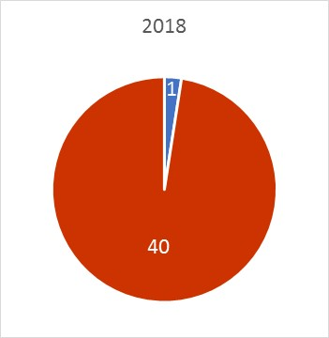
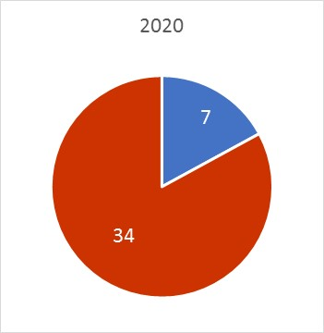
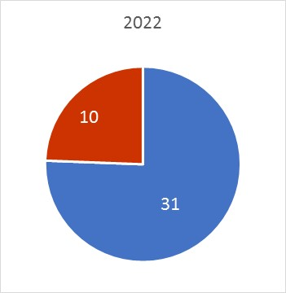
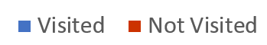
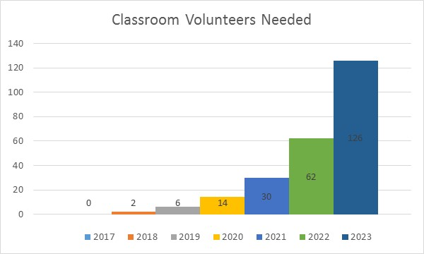
Sao Carlos Public School Coverage
Pilot Starts in 2017 with Little Citizens
All Public Schools in Sao Carlos covered in 2023 3

Slide 8
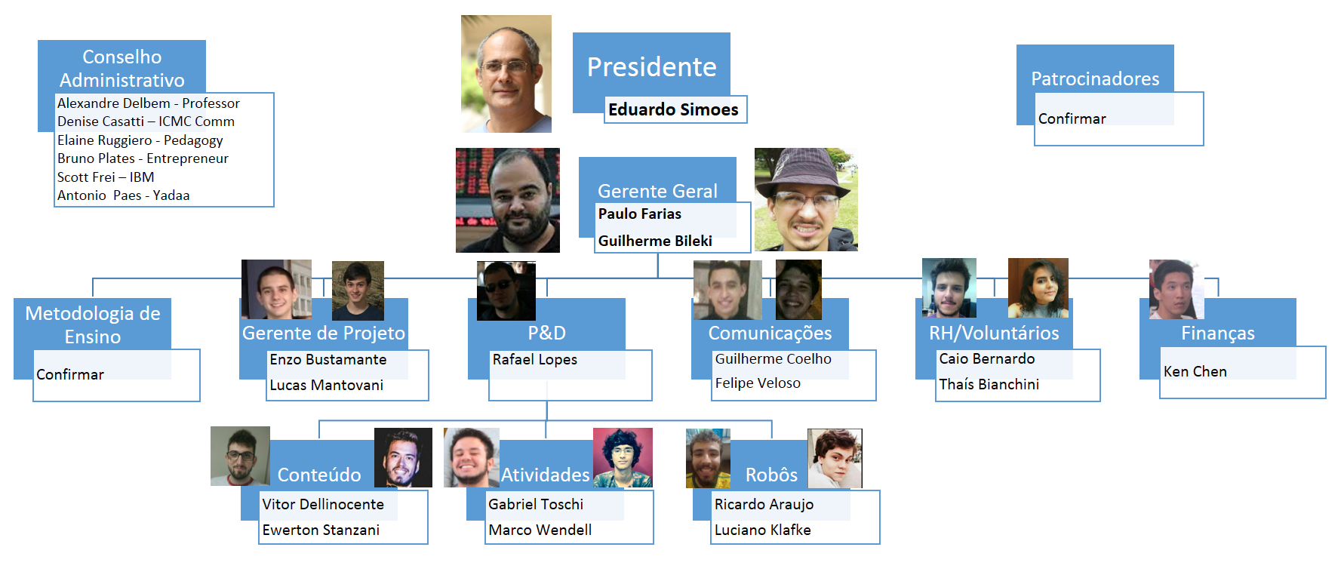
Organizational Structure

Slide 9


